Slide 1
State Revolving Fund (SRF) Public Meeting
April 30th
2024
Buffalo Mountain Metropolitan District

Slide 2
Meeting Agenda
1. Discuss services provided by the district
2. Present challenges and projects to come
3. Show how the district is paying for these projects and loans
4. Explain
  Project alternatives
  Preferred alternatives
  Projected rate increases
  Construction activities and environmental impacts
  Where to obtain information

Slide 3
Services Provided by
Buffalo Mountain Metropolitan District
Architectural Review
Covenant Enforcement
Drinking Water
  Treatment
  Distribution System
Pedestrian Path
Road Maintenance
  Small Road Repairs
  Guardrails
  Striping
Sanitary Sewer Collection
Snow Plowing - County Roads
Storm Sewer Collection
  Drainage Ditches
  County Culverts
  Underground Storm Sewer Infrastructure

Slide 4
Drinking Water
The Most Important Natural Resource on Earth

Slide 5
Future Construction Projects

Slide 6
Improving Water Infrastructure
Minimize water outages during emergency water main breaks and planned repairs
Expedite emergency repairs
Help protect water quality during a shutdown
Replacing/ Adding Water Main Isolation Valves:
Upgrade Booster Stations
  Continue to replace aging PLCs/computers
  Improve automation to help assist with redundancy and independent function in case of emergency, ie communication loss, equipment failure, etc
  Upgrade instrumentation equipment
Upgrading Water Distribution System:

Slide 7
Improving Water Infrastructure
Will help with emergency fire fighting response:
Recently replaced water storage facilities can hold more water capacity
Additional Pressure Reducing Valves (PRV) will automatically move water in the distribution system during fire flow/main break events
Hydrants are on the Capital Improvement Project (CIP) list for annual replacement and maintenance
District works closely with Summit Fire and EMS to have the highest ISO rating which in turn, lowers homeowners insurance.

Slide 8
Large Future Construction Projects
Replacement Projects
“Looped” Projects
The District has identified isolated areas of high water main breaks and poor soil conditions and concluded that water main replacement is needed
All main and service line leaks are recorded in our GIS system to assist with asset management planning
Pipe and soil conditions are assessed during all repairs and construction projects to also assist in future planning
After much analysis on the water distribution system, it is apparent that there are, in areas, only single feed transmission lines that supply water to the entire district or large sections.
Part of the proposed CIP projects is to correct these areas and to have more redundancy, especially during repairs.
These projects will also help with water quality in certain areas
Interconnections between zones will be accomplished through the new PRVs
The District is working with neighboring water providers to establish an “interconnect” between the two systems. This will allow one water district, to help supplement water during an catastrophic emergency
Other Projects
Pressure Reducing Valves (PRVs)
Booster Station Upgrades

Slide 9
Results
The District is facing increasing costs from materials, excavators, equipment, vendors, etc
We have completed a long range 35 year Capital Improvement Plan (CIP) that has identified, estimated and prioritized a list of needed projects in our water/sewer and storm sewer systems.
A rate study was done in conjunction with the CIP and made it clear that the district needs to obtain funds from outside sources to alleviate large rate increases.

Slide 10
How is the district paying for these projects?
We are working with the state to receive a federal loan
The federal government is allocating funds for water/sewer system projects through the Bipartisan Infrastructure Law (BIL) that will be paid back as a long term/ low interest rate loan

Slide 11
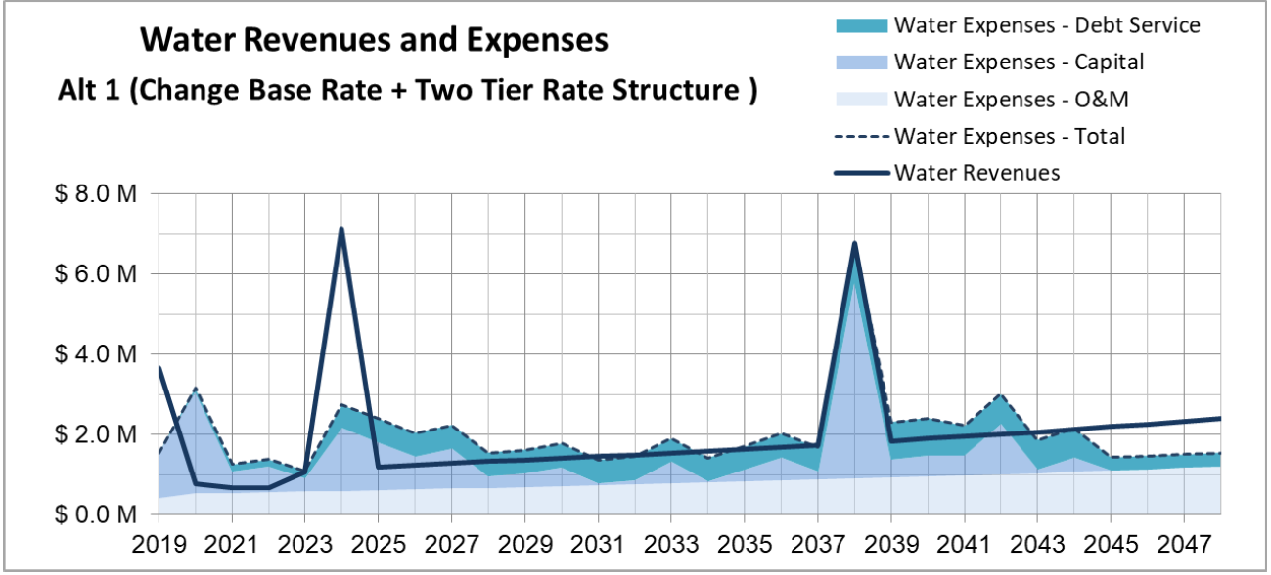

Slide 12
Project Alternatives and Customer Impacts
Do nothing
Have more watermain breaks and outages and wastefully pay contractors to repair failing infrastructure. District will experience more frequent water main breaks and outages. Next large wildland or structure fire could over burden our system.

Slide 13
Project Alternatives and Customer Impacts
Do the right thing
Plan, budget and prepare for long range projects and expenditures that will increase services, reduce water outages and save in the long term by proactively replacing and repairing our systems.

Slide 14
Project Alternatives and Customer Impacts
Rate Increase?
The district performed a long range capital improvement plan (CIP) and associated rate study in 2022. These reports included a federal loan that is accounted for in the planned water/sewer rates increases. The district will be raising rates at a rate of 5% for water from 2024 to 2028 then that number will lower to 3% for the foreseeable future. The sewer system will increase at a rate of 3%. The new loan should not effect your water/ sewer bill

Slide 15
Project Area Maps

Slide 16
Project Area Maps

Slide 17
Project Area Maps

Slide 18
Environmental Impacts
The district is working with independent contractors and engineers to provide an unbiased review of our projects to show any affects on our local environment and streams and have initially found that we will not need to obtain additional state and federal permits for the following agencies:
SHPO - State (of Colorado) Historical and Preservation Office
U.S. Army Corps of Engineers
Colorado Division of Water Resources

Slide 19
THANK YOU!
For more information/questions, please contact District Manager – Will Yates
Phone
970-513-1300
Email
Will@bmmd.org
Website
https://bmmd.colorado.gov

